Slide 1

Computer Security
Botong Ou
NESL, UCLA
Dan Boneh

Slide 2
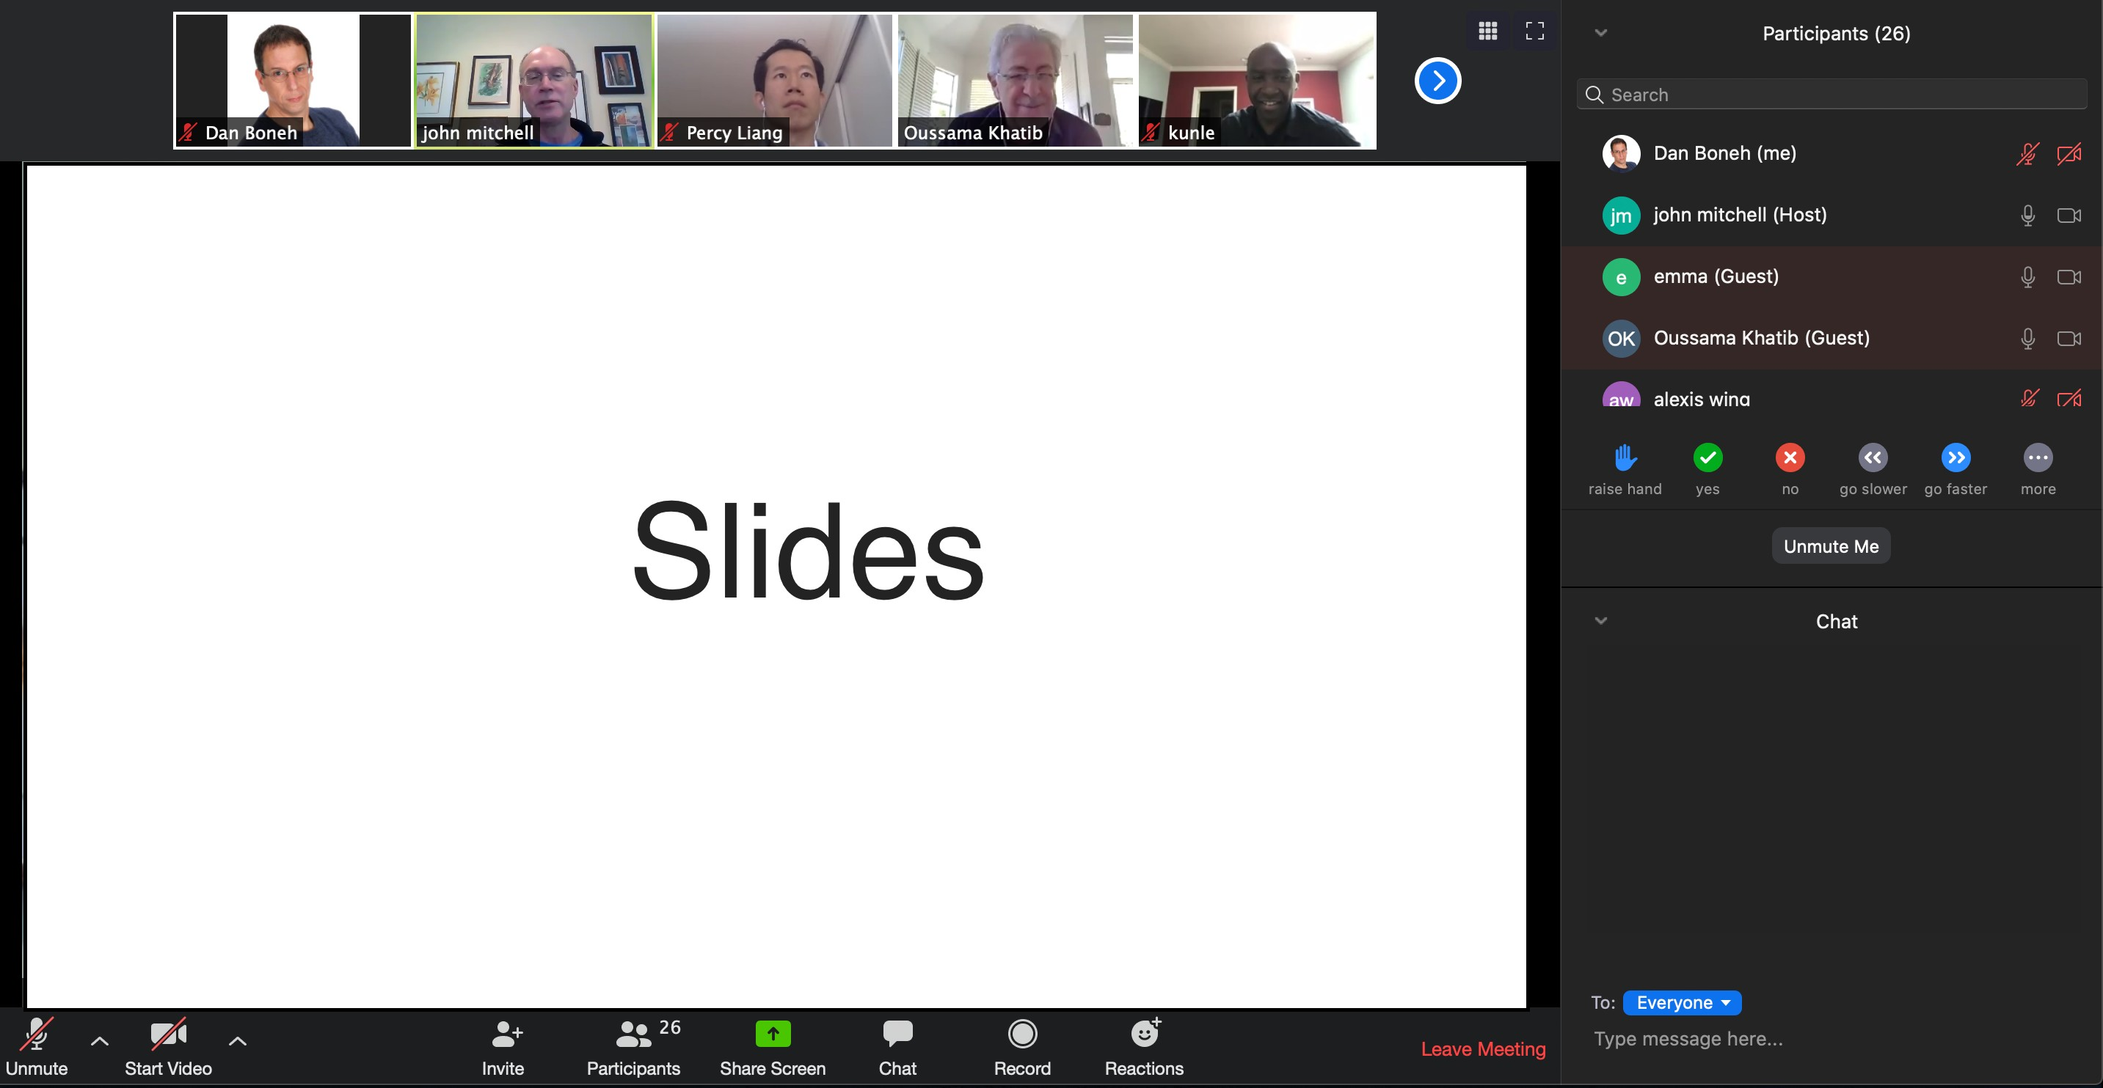
Live lectures on Zoom
Lectures are recorded … posted on canvas
ask questions

Slide 3
The computer security problem
Lots of buggy software
Social engineering is very effective
Money can be made from finding and exploiting vulns.
Marketplace for exploits
Marketplace for privacy information (PPI)
Many methods to profit from owned machines
current state of computer security
Dan Boneh

Slide 4
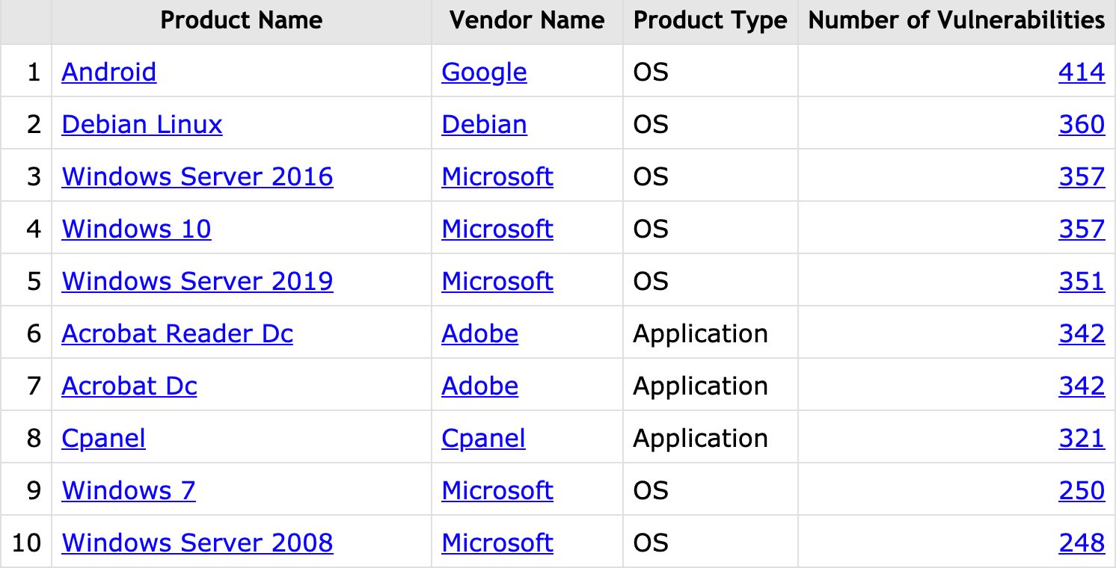
Top 10 products by total number of “distinct” vulnerabilities in 2019
source: https://www.cvedetails.com/top-50-products.php?year=2019
Dan Boneh

Slide 5
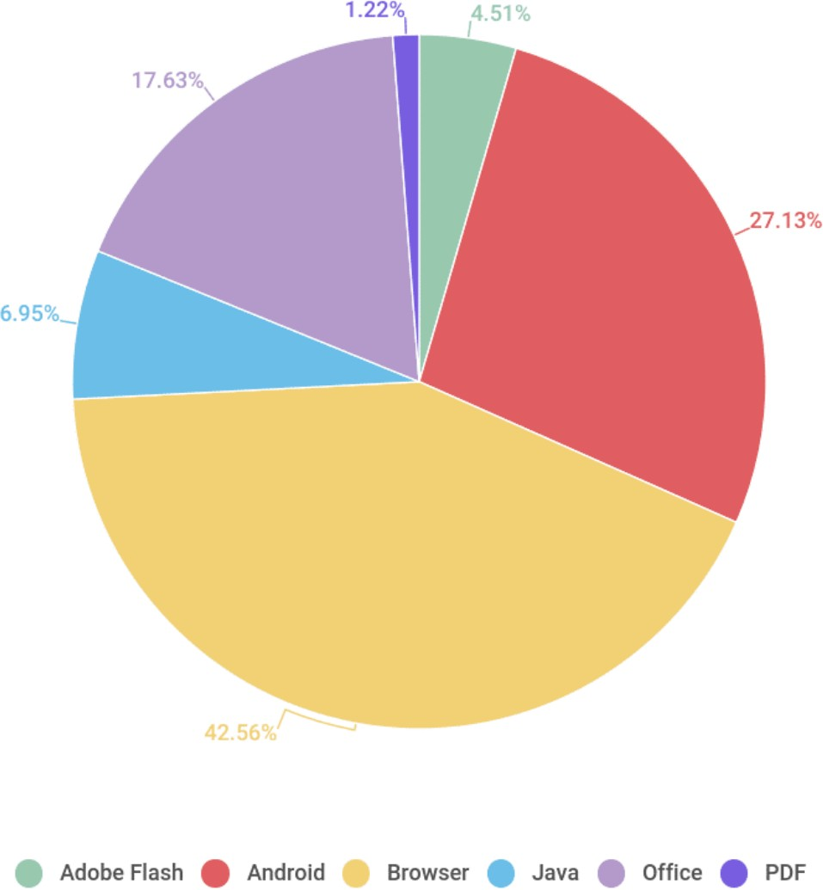
Vulnerable applications being exploited
Office
Java
Android
Browser
Source: Kaspersky Security Bulletin 2017
Dan Boneh

Slide 6

Why so many security bugs? Case study: Zoom client
Users have an expectation of privacy. But:
(1) Problems with crypto
(Marczak and Scott-Railton, April 2020)
(2) Turn on camera without permission
(J. Leitschuh, July 2019)
https://zoom.com/[meeting]
Browser
Zoom app
launch
zoom.com
user’s MacOS system
Notes:
Zoom does not implement true end-to-end encryption, they have the theoretical ability to decrypt and monitor Zoom calls
This vulnerability allows any website to forcibly join a user to a Zoom call, with their video camera activated, without the user’s permission.

Slide 7
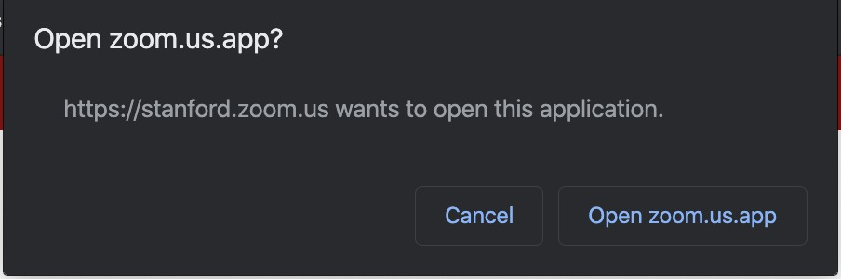
Why so many security bugs? Case study: Zoom client
Users have an expectati
Problems with crypt
(2) Turn on camera without permission
(J. Leitschuh, July 2019)
https://zoom.com/[meeting]
on of privacy. But:
o (Marczak and Scott-Railton, April 2020)
ser clicks (J. Leitschuh, July 2019)
Browser
Zoom app
Can we bypass the
security dialog?
launch
zoom.com
user’s MacOS system

Slide 8
Why so many security bugs? Case study: Zoom client
Local Zoom web server listens on port localhost:19421
To launch app: web page from zoom.com tells
browser to send an HTTP request to the local web server
Web requests do not require a dialog …
Browser
Zoom web server
Can this be attacked?
zoom.com
http://localhost:19421/launch?action=join&confno=[confrence number]
Notes:
This is what happened during the mid2019, there is no diag to notify user the zoom will be open. Also the camera will be started by default

Slide 9
The problem
[J. Leitschuh, July 2019]
Any web site can send a request to the local web server
Joins users to conference w/o user’s knowledge!
What happened next? Responsible disclosure, 90 days (CVE-2019-13450).
Fixed by Zoom. Web server removed by Apple’s MRT tool.
Browser
Zoom web server
evil.com
http://localhost:19421/launch?action=join&confno=[confrence number]
Notes:
responsible disclosure is a vulnerability disclosure model in which a vulnerability or an issue is disclosed only after a period of time that allows for the vulnerability or issue to be patched or mended
Malware Removal Tool

Slide 10
Why so many security bugs? Case study: Zoom client
Users have an expectation of privacy. But:
(1) Problems with crypto
(Marczak and Scott-Railton, April 2020)
Turn on the camera (J. Leitschuh, July 2019)
Disable MacOS hardened runtime (P. Wardle, April 2020) Defends against code injection, library hijacking, and process memory space tampering.
Once user gives Zoom access to camera and mic,
MacOS ensures that entire application code does not change
Notes:
Attacker can inject code to disable the macOS library validation. This is a “shady” technique used by zoom — one that’s also used by Mac malware — to install the Mac app without user interaction

Slide 11
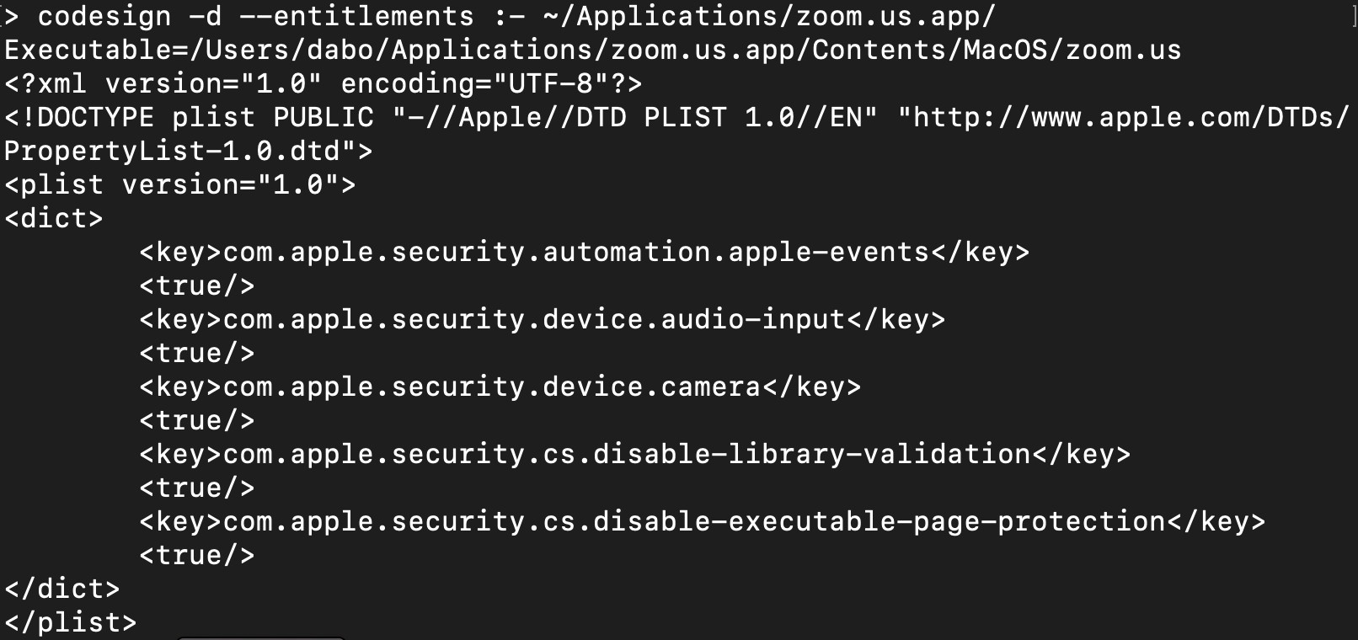
What happens if protection is disabled?
requires user approval
Can this be abused?

Slide 12
The impact
[Wardle, 4/2020]
dynamic libraries loaded at Zoom startup
libssl.1.0.0
Zoom app
curl64
⋮
User approved access to camera & mic
user’s MacOS system

Slide 13
The impact
[Wardle, 4/2020]
Attacker installs malware library that proxies libssl.
⇒ has access to camera & mic
hardened runtime does not notify user of change to libssl!
libssl.1.0.0
libssl.1.0.0
Zoom app
curl64
⋮
disable-library-validation:true
user’s MacOS system

Slide 14
Don’t try this at home !
Dan Boneh

Slide 15
What motivates attackers?
… economics
Dan Boneh

Slide 16
Why compromise systems?
1. IP address and bandwidth stealing
Attacker’s goal: look like a random Internet user
Use the IP address of infected machine or phone for:
Spam (e.g. the storm botnet)
Spamalytics:
1:12M pharma spams leads to purchase 1:260K greeting card spams leads to infection
Denial of Service: Services: 1 hour (20$), 24 hours (100$)
Click fraud (e.g. Clickbot.A)
Notes:
A botnet is a number of Internet-connected devices, each of which is running one or more bots. Botnets can be used to perform Distributed Denial-of-Service (DDoS) attacks, steal data, send spam, and allows the attacker to access the device and its connection.
Clickbot.A is operated by using victims' computers to automatically click on pay-per-click Internet advertisements.

Slide 17
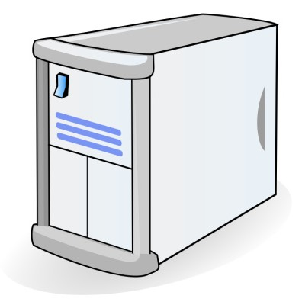
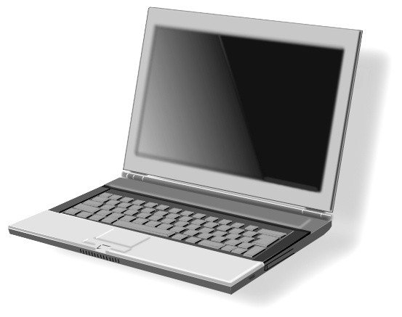


Why compromise systems?
2. Steal user credentials
keylog for banking passwords, corporate passwords, gaming pwds
Example: SilentBanker (and many like it)
User requests login page
Malware injects
Javascript
Bank sends login page needed to log in
Bank
When user submits information, also sent to attacker
Man-in-the-Browser (MITB)
Similar mechanism used by Zeus botnet, and others
Notes:
Zeus, ZeuS, or Zbot is a Trojan horse malware package that runs on versions of Microsoft Windows. While it can be used to carry out many malicious and criminal tasks, it is often used to steal banking information by man-in-the-browser attack

Slide 18
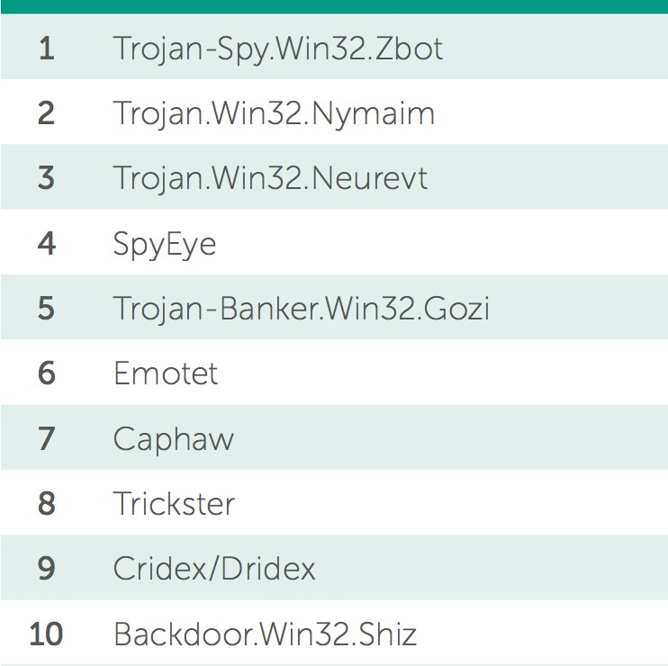
Lots of financial malware
records banking passwords via keylogger
spread via spam email and hacked web sites
maintains access to PC for future installs
Source: Kaspersky Security Bulletin 2017
Dan Boneh

Slide 19
Similar attacks on mobile devices
Example: FinSpy.
Works on iOS and Android
(and Windows)
once installed: collects contacts, call history, geolocation, texts, messages in encrypted chat apps, …
How installed?
Android pre-2017: links in SMS / links in E-mail
iOS and Android post 2017: physical access
Notes:
FinSpy is able to monitor almost all device activities, including record VoIP(Voice over IP) calls via external apps such as Skype or WhatsApp.

Slide 20
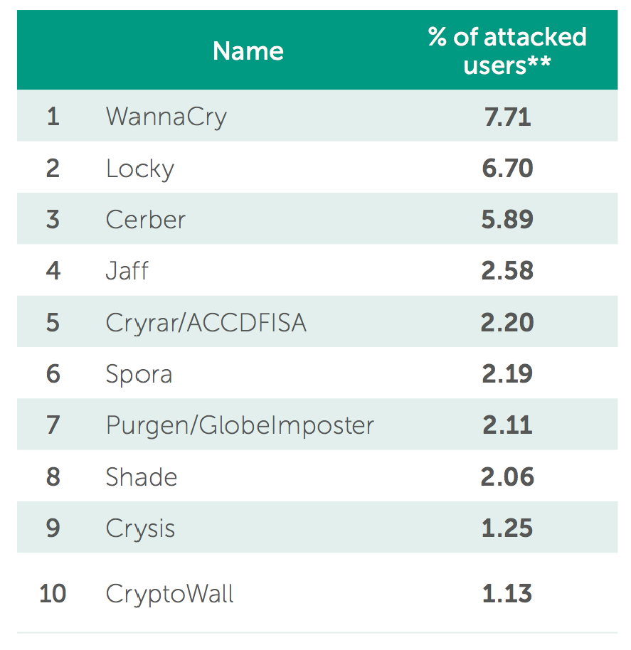
Why own machines:
Ransomware
a worldwide problem
Worm spreads via a vuln. in SMB (port 445)
Apr. 14, 2017: Eternalblue vuln. released by ShadowBrokers
May 12, 2017: Worm detected
(3 weeks to weaponize)
Notes:
In computer networking, Server Message Block (SMB), one version of which was also known as Common Internet File System (CIFS /sɪfs/),^{[1][2]} is a communication protocol^{[3]} for providing shared access to files, printers, and serial ports between nodes on a network.
The Shadow Brokers is a hacker group. They published several leaks containing hacking tools from the National Security Agency (NSA

Slide 21
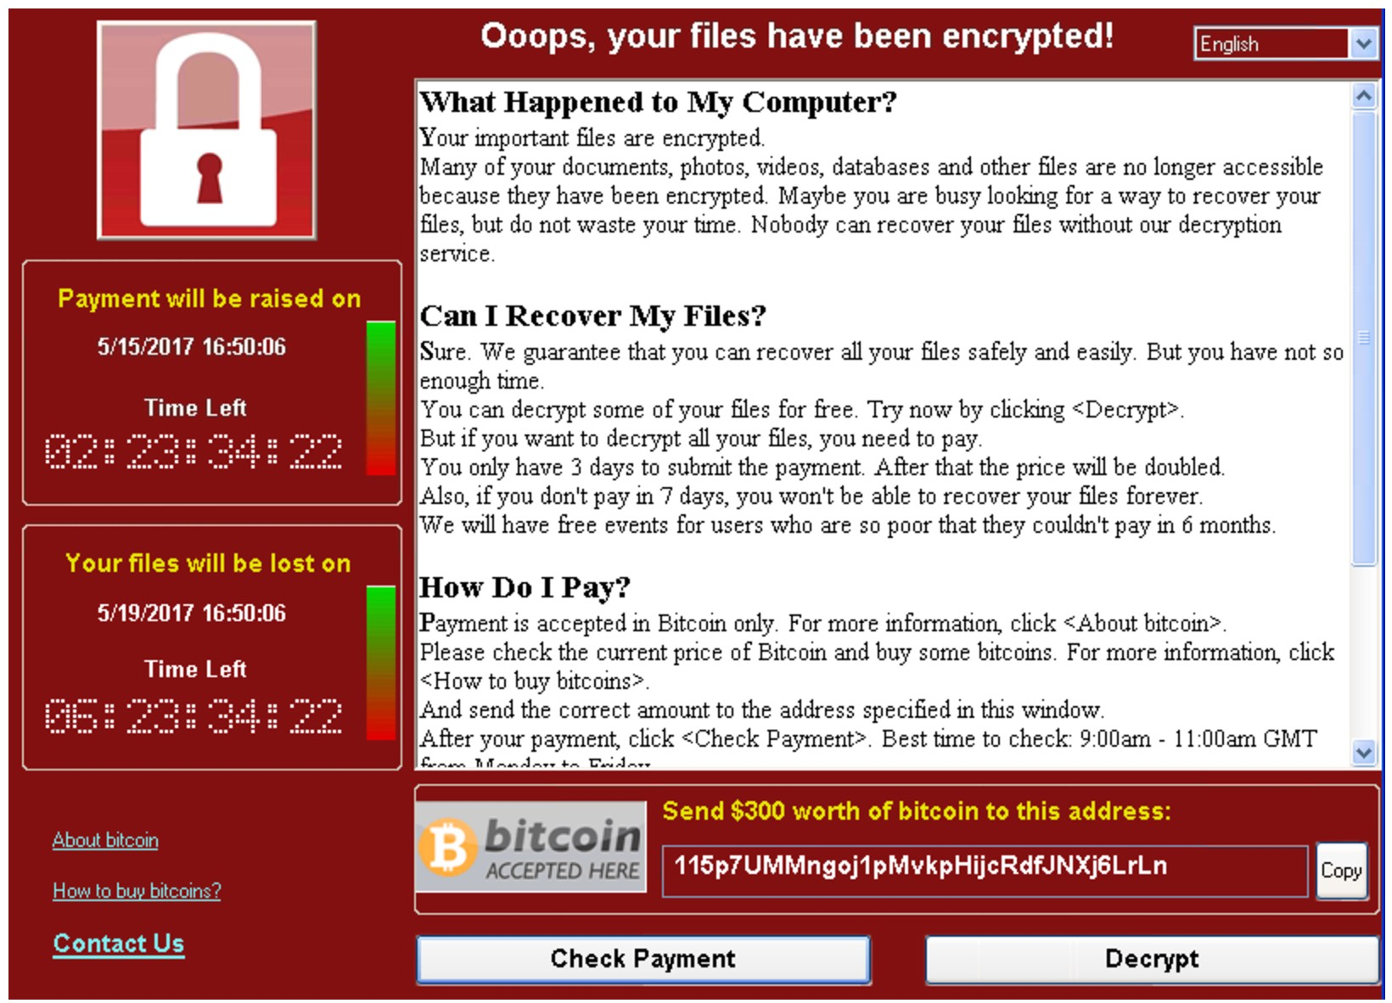
ransomware
WannaCry

Slide 22
Server-side attacks
Data theft: credit card numbers, intellectual property
Example: Equifax (July 2017), ≈ 143M “customer” data impacted
Exploited known vulnerability in Apache Struts (RCE)
Many many similar attacks since 2000
Political motivation:
– DNC, Tunisia Facebook (Feb. 2011),
GitHub (Mar. 2015)
Infect visiting users
Notes:
Apache Struts is an open-source web application framework for developing Java EE web applications.
Equifax Inc. is an American multinational consumer credit reporting agency

Slide 23
Infecting visiting users. Example: Mpack
PHP-based tools installed on compromised web sites
Embedded as an <iframe> on infected page
Infects browsers that visit site
Features
management console provides stats on infection rates
Sold for several 100$
Customer care can be purchased, one-year support contract
Impact: 500,000 infected sites (compromised via SQL injection)
Several defenses: e.g. Google safe browsing
Notes:
MPack is a PHP-based malware kit produced by Russian crackers
<iframe> is a tag which specifies inline codes in javascript
MPack is sold as commercial software (costing $500 to $1,000 US), and is provided by its developers with technical support and regular updates of the software vulnerabilities it exploits. Modules are sold by the developers containing new exploits. These cost between $50 and $150 US depending on how severe the exploit is. The developers also charge to make the scripts and executables undetectable by antivirus software.

Slide 24
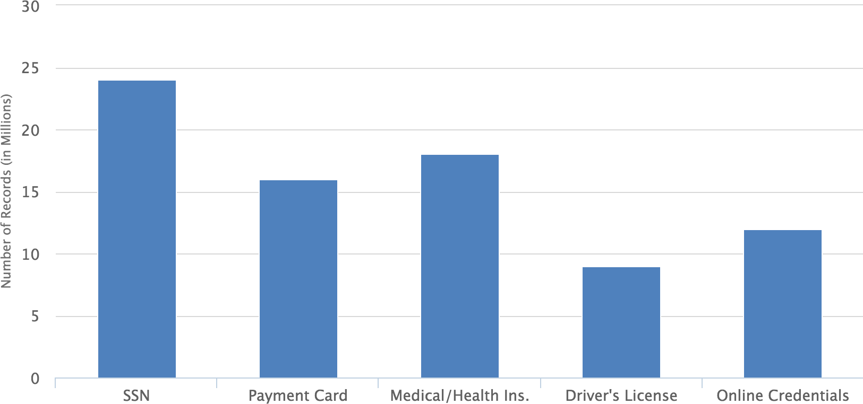
Data theft: what is stolen (2012-2015)
Source: California breach notification report, 2015
Dan Boneh

Slide 25
















How companies lose customer data
insider misuse/attack
Physical document loss
Accidental disclosure
8%
21%
22%
17%
32%
malware/hacking
lost/stolen laptops or servers
How do we have this data?
Source: PrivacyRights.org, 2020
Dan Boneh

Slide 26
The Marketplace for Vulnerabilities
Dan Boneh

Slide 27
Marketplace for Vulnerabilities
Option 1: bug bounty programs (many)
Google Vulnerability Reward Program: up to $31,337
Microsoft Bounty Program: up to $100K
Apple Bug Bounty program: up to $200K
Stanford bug bounty program: up to $1K
Pwn2Own competition: $15K
Option 2:
Zerodium: up to $2M for iOS, $2.5M for Android
… many others
(2019)
Dan Boneh
Notes:
ZERODIUM is the leading exploit acquisition platform for premium zero-days and advanced cybersecurity research

Slide 28
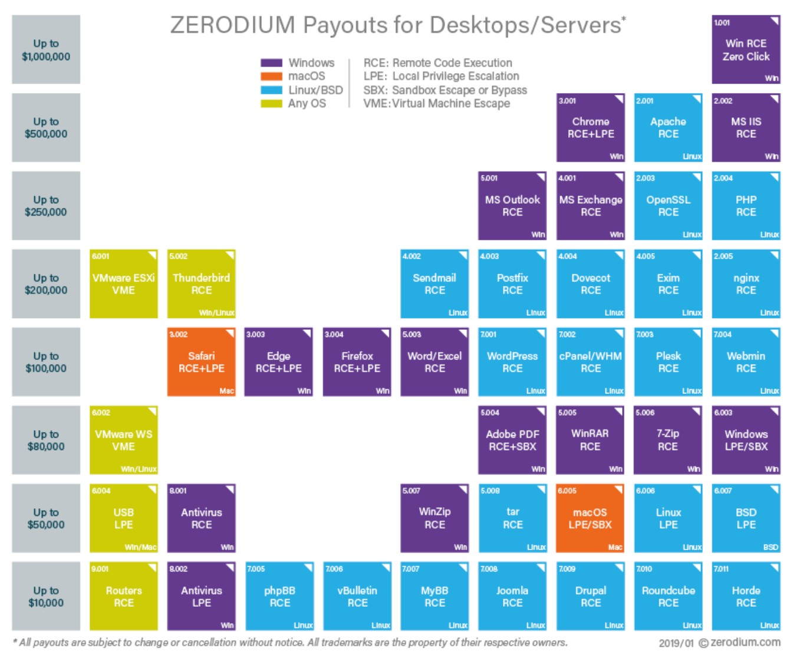
Marketplace for Vulnerabilities
RCE: remote code execution LPE: local privilege escalation SBX: sandbox escape
Source: Zerodium payouts
Dan
Boneh

Slide 29
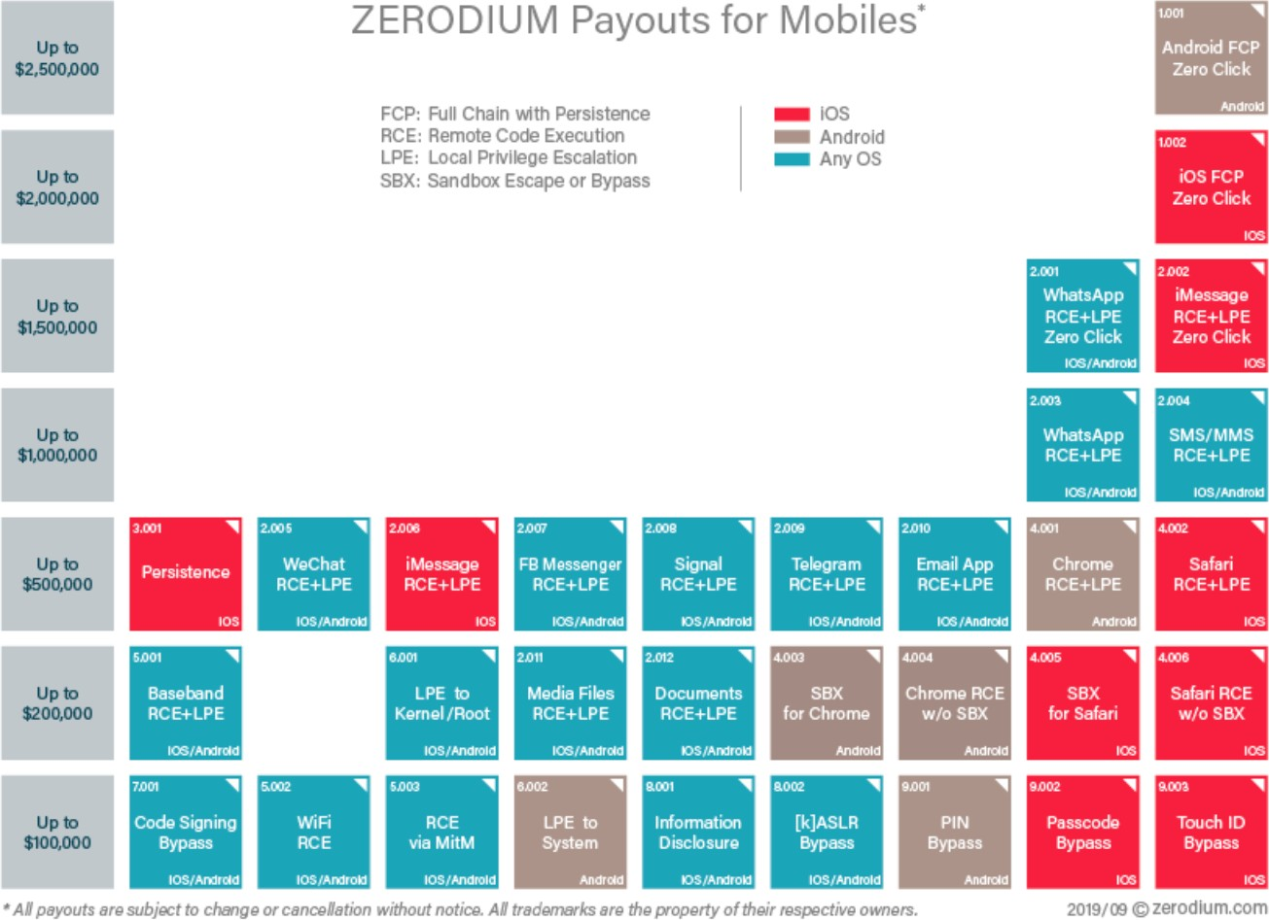
Marketplace for Vulnerabilities
RCE: remote code execution LPE: local privilege escalation SBX: sandbox escape
Source: Zerodium payouts
Dan Boneh
Notes:
full chain with persistence

Slide 30
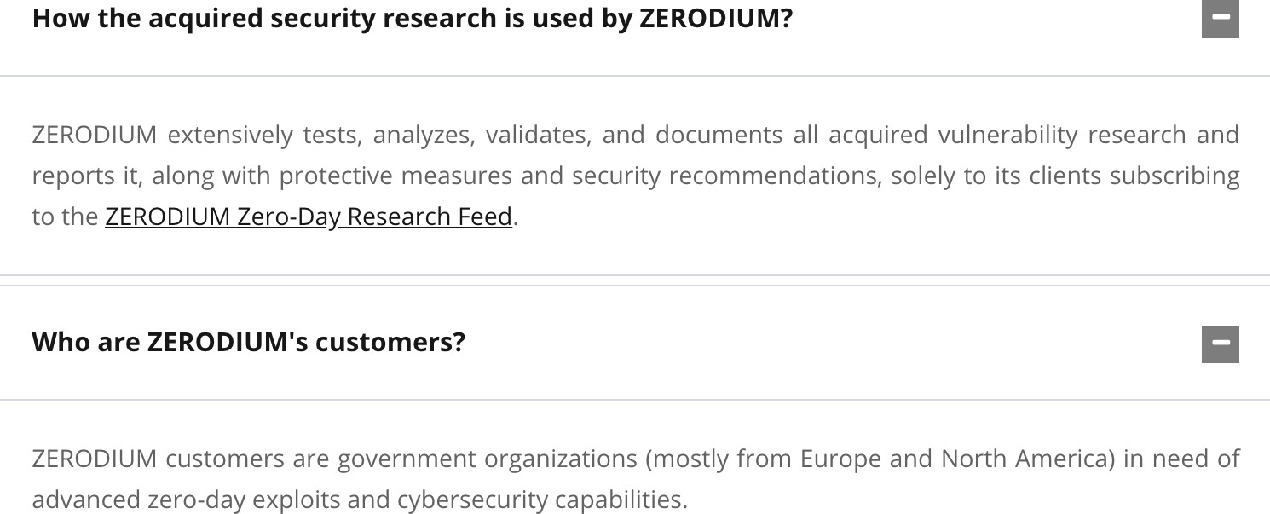
Why buy 0days?
https://zerodium.com/faq.html
Dan Boneh

Slide 31
Ken Thompson’s clever Trojan
Turing award lecture
(CACM Aug. 1984)
What code can we trust?
Dan Boneh
Notes:
Reflections on Trusting Trust

Slide 32
What code can we trust?
Can we trust the “login” program in a Linux distribution? (e.g. Ubuntu)
No! the login program may have a backdoor
⇾ records my password as I type it
Solution: recompile login program from source code
Can we trust the login source code?
No! but we can inspect the code, then recompile

Slide 33
Can we trust the compiler?
No! Example malicious compiler code:
compile(s) {
if (match(s, “login-program”)) { compile(“login-backdoor”); return
}
/* regular compilation */
}

Slide 34
What to do?
Solution:
inspect compiler source code, then recompile the compiler
Problem: C compiler is itself written in C, compiles itself
What if compiler binary has a backdoor?

Slide 35
Thompson’s clever backdoor
Attack step 1: change compiler source code:
compile(s) {
if (match(s, “login-program”)) {
compile(“login-backdoor”); return
}
if (match(s, “compiler-program”)) {
compile(“compiler-backdoor”); return
}
(*)
/* regular compilation */
}

Slide 36
Thompson’s clever backdoor
Attack step 2:
Compile modified compiler ⇒ compiler binary
Restore compiler source to original state
Now: inspecting compiler source reveals nothing unusual
… but compiling compiler gives a corrupt compiler binary
Complication: compiler-backdoor needs to include all of (*)

Slide 37
What can we trust?
I order a laptop by mail. When it arrives, what can I trust on it?
Applications and/or operating system may be backdoored
⇒ solution: reinstall OS and applications
How to reinstall? Can’t trust OS to reinstall the OS.
⇒ Boot Tails from a USB drive (Debian)
Need to trust pre-boot BIOS,UEFI code. Can we trust it?
⇒ No! (e.g. ShadowHammer operation in 2018)
Can we trust the motherboard? Software updates?

Slide 38
So, what can we trust?
Sadly, nothing … anything can be compromised
but then we can’t make progress
Trusted Computing Base (TCB)
Assume some minimal part of the system is not compromised
Then build a secure environment on top of that
TrustZone for ARM, SGX for Intel chip

Slide 39
Next Course: Cryptography
THE END
Dan Boneh

